Slide 1
Origin of State The Evolutionary Theory

Slide 2
1. The origin of modern state is marked by a long evolutionary process. The state is neither the result of an artificial creation nor can it said to have originated at a particular period of time. It is, on the other hand, the product of growth - a slow and steady evolution extending over a long period of time and embracing many elements in its development, prominent among which are kinship, religion, property and the need for self-defense from within and outside.
2. In Political Science, there are many theories to explain the origin of state like: the Theory of Divine Origin, the Theory of Force, the Theory of Social Contract, the Patriarchal or Matriarchal Theories, the Historical or Evolutionary Theory. Among these theories, the Historical or Evolutionary Theory is now accepted as the correct theory of the origin of state. While explaining this theory, light can be thrown on the other theories that influenced the development of state in one way or the other.

Slide 3
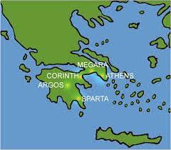
3. Greek City-State
The first relatively clear manifestation of a state system is that of ancient Greece (500 BC – 100 BC) then known as Hellas. Ancient Greece was not a nation-state the way it is today. Rather it was a system of mostly small city – states. Athens was the largest and most famous, but there were also many other city states such as Sparta and Corinth. Together, they formed the first state system in Western history. The ancient Greek state system was eventually destroyed by more powerful neighboring empires and in due course of time, the Greeks became the subjects of the Roman Empire (200 BC – 500 AD).
4. Roman Empire
The Romans developed a huge empire in the course of conquering, occupying and ruling most of Europe and a large part of the Middle East and North Africa. The Romans had to deal with the numerous political communities that occupied these areas, but they did it by subordinating them rather than recognizing them. Therefore, one finds the application of force during the Roman period.

Slide 4
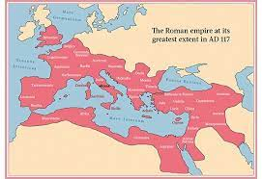

Slide 5
5. Existence of other empires
It should be mentioned that there were other political systems and empires further afield. North Africa and the Middle East formed a world of Islamic civilization which originated in the Arabian peninsula in the early years of the 7th century. There were also empires in what are today Iran and India.
6. Roman empire under threat
Under the Roman empire, the only option for political communities was either subordination to Rome or revolt. Eventually, those communities on the periphery of the empire began to revolt. The Roman army could not control the revolts and began to retreat. On several occasions, the city of Rome itself was invaded and shattered by the barbarian tribes. In this way, the Roman empire was finally brought to an end after many centuries of political success and survival.
7. The Dark age
The collapse of the Roman empire left Western Europe in the Dark Ages (476 AD – 800 AD), a period marked by a decline in law and order, and learning and a decrease in population. Power and authority, once concentrated in the hands of the Romans, became fragmented among many petty kings and warlords who provided a modicum of security from local lawlessness and barbarian raids. However, the lands that belonged to these new kings and warlords was not fixed. It oscillated and vacillated as frequent encroachments were made by the aggressors on each other’s territory.

Slide 6
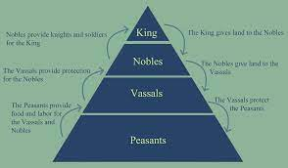
8. Feudalism
Protection improved as feudalism evolved, reaching its full form between the 11th and 13th centuries in the Middle age (801 AD – 1400 AD). Feudalism called for lords/nobles to distribute land to vassals and to offer them protection. In return, the vassals contributed money and soldiers to their lords. Over the centuries, a pattern of consolidation of the fragmented feudal units gradually developed to provide a territorial base for larger states. Before large independent states began to emerge, there was the rise of the Holy Roman Empire that Christianized almost the whole of Europe and parts of the Middle East.
9.The Holy Roman Empire
The Holy Roman Empire (962 AD - 1806 AD) took shape, usually under the role of a German emperor approved by the Roman Catholic Pope. The Holy Roman Empire existed on territory presently shared by Austria, Belgium, the Republics of Czech and Slovakia, Germany, the Netherlands and Italy. This empire was a weak governmental system with territorial boundaries that tended to recede rather than expand. During this period of time, an important step in the formation of the state was the emergence of strong kings.

Slide 7
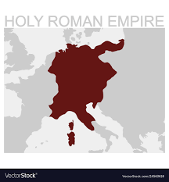

Slide 8
10. Emergence of powerful kings and the Divine Theory of state.
A king usually began as a lord, but overtime, came to rule over other lords and large territories. Not only did the kings have to gain control over the feudal lords within their domains; these rulers also had to wrest themselves free of the control of Roman Catholic Pope at the same time. The Roman Catholic Church was a cultural unifier for centuries in Europe, and the Pope had considerable powers. The Divine Theory allowed some of the kings of Europe to view their sovereignty as completely unbridled authority. They took seriously the views of French philosopher Jean Bodin (1530-1596) who claimed that the monarch had supreme power over the citizens. Thomas Hobbes (1588-1679), the English philosopher, maintained that without a monarch’s firm control, life would be ‘poor, nasty, brutish and short’.
11. Renaissance in Europe and split in Christianity
Fortunately for king and the evolution of modern state in Europe, the Pope’s power declined. The Protestant Reformation of the 16th century severely shook the Roman Catholic Church. In fact, several different Protestant Churches appeared during the Renaissance (1400-1600). This period was an era of enlightenment and reforms that marked the end of the Middle Ages, an era that helped to create the cultural atmosphere that made the Protestant Reformation possible. During this period, various philosophers and thinkers talked about the Social Contract Theory as per which the people would enter into a contract with the sovereign for running the affairs of the state. This has profoundly influenced the rise of modern state.

Slide 9
12. The Treaty of Westphalia
Between 1400 and 1600, territorial units began to appear that would foreshadow some of the modern states of today. Primarily these territorial states were England, France, Holland, Portugal, Russia, Spain, Sweden and the small principalities known collectively as Germanies. Divided along Catholic or the Protestant lines, some of these states fought intense, bloody wars over whether Catholic or the Protestant faith would prevail in Europe. Thirty years’ religious warfare finally culminated in the Thirty Years War (1618-1648). The treaty ending this war is known as the Treaty of Westphalia (1648). It recognized the sovereignty of each king. This legal status meant that no authority operated above the king, and states were not to interfere with one another because they were legal equals. Sovereignty is the cornerstone of the modern state, and many scholars use the date 1648 to mark the beginning of the modern state system.

Slide 10
Pluralist sovereignty
Later on, the American Revolution of 1776 and the French Revolution of 1789 jolted the monarch’s powerful position since these revolutions rejected the entire concept of monarchical rule. In time, sovereignty passed from the state to the people, meaning that the people were the ultimate source of all legitimate political authority. This locus of authority in the people became known as popular sovereignty, and the people exercised this authority mainly through elections to choose those who were to govern. Popular sovereignty spread as an ideal, with some European sates turning to democracy in the 19th century.

